Slide 1
πSec
Sprint 3
Group 4

Slide 2
Topics for today
1
Sprint 3 review
What we had planned and what has been completed
2
Physical product
How we tackled all the wires in a neat way
3
Security and Testing
A detailed view of the pieces
4
Minimum viable product
How everything came together
5
Sprint 4 plans
What we are going to do next

Slide 3
Sprint 3 review
Implement motion detection
Sessions on the web interface
Send text alerts and emails
Connect web server to database
Sprint 4

Slide 4
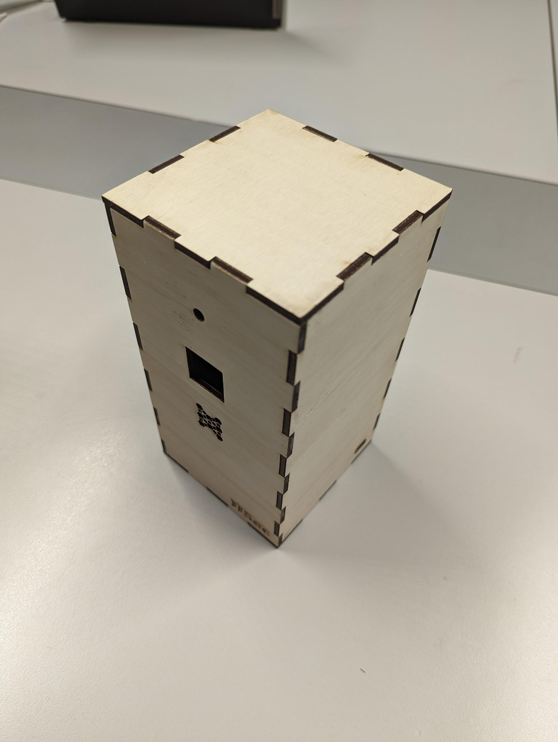
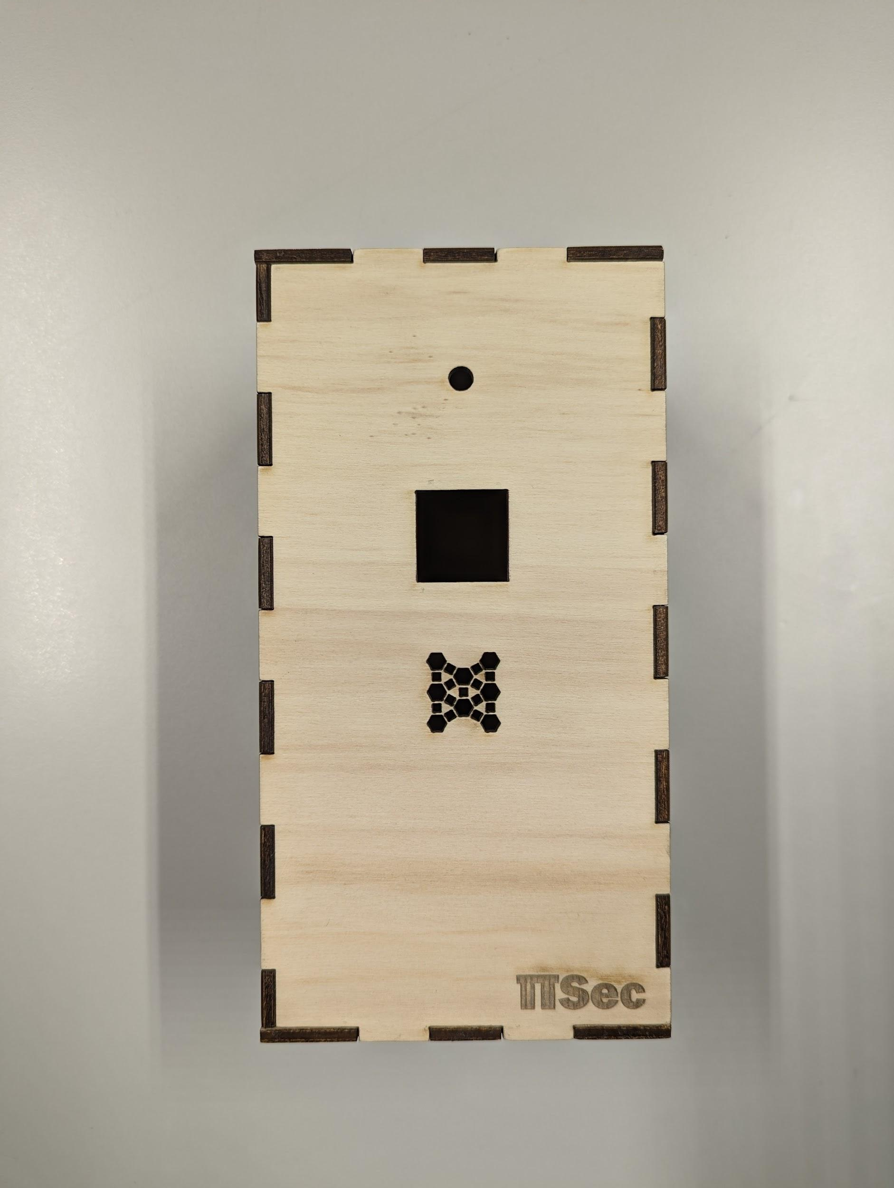
Box design
Front view
Top down view

Slide 5
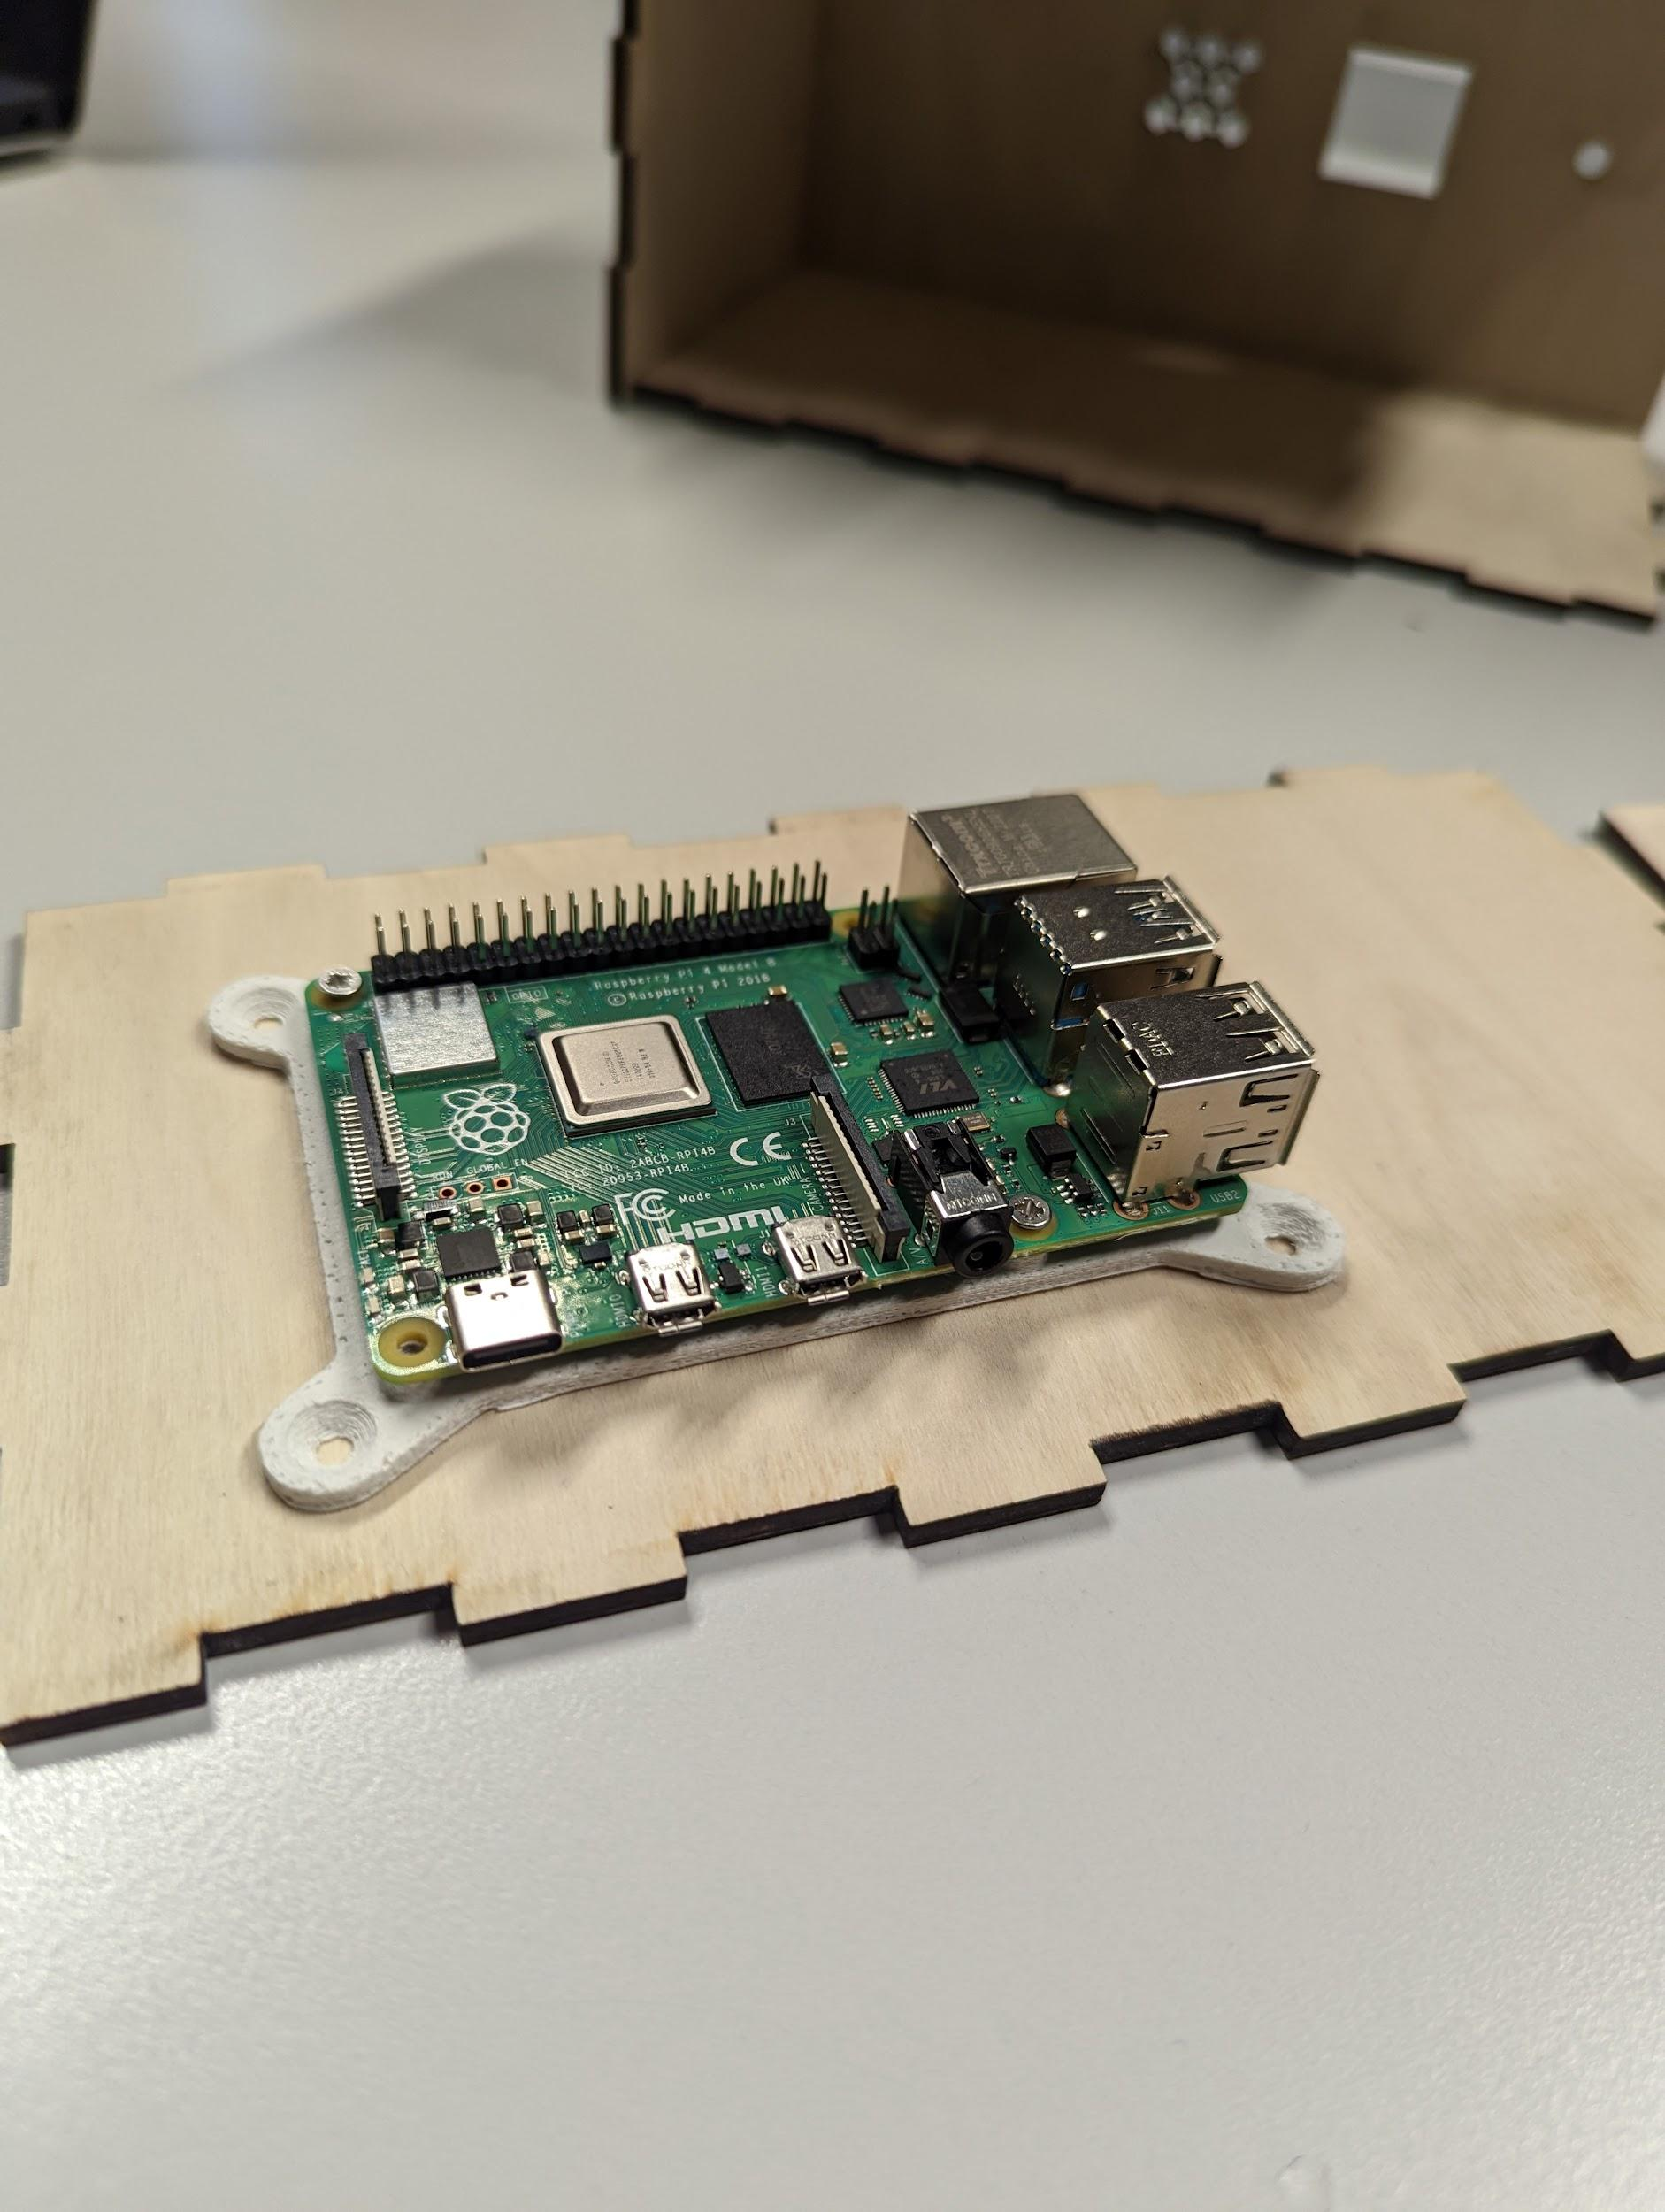
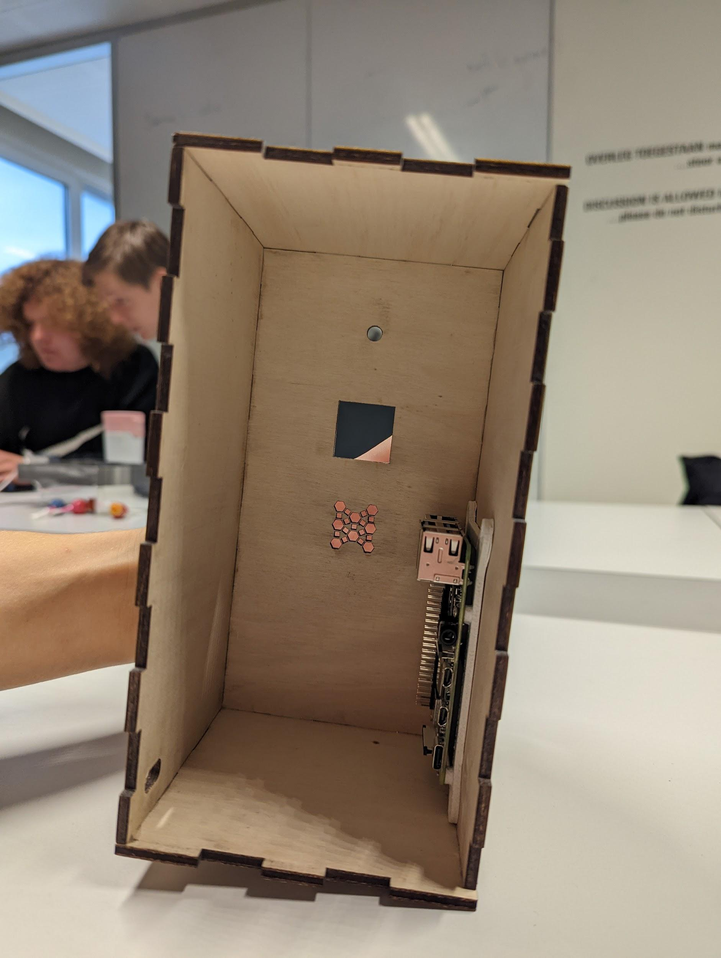
Hardware placement
Camera peephole
Motion sensor slot
Microphone mesh
How the Raspberry Pi scales to the box
Charging cable slit

Slide 6
Testing
Unit testing
Manual testing
Will be implemented for code coverage
Storing alerts in database
Motion detection
Navigation and interaction in web interface

Slide 7







Security decisions
Streaming
Internal storage
Video will be streamed through HLS (HTTP Live Streaming) and encrypted with AES-128
All recordings will be stored internally
Encryption
Closing ports
All traffic will use HTTPS, so it’s encrypted
Only port 443 (HTTPS) will be opened
Password
Input sanitisation
Passwords will be hashed, salted and peppered in the browser and again server side
Input will be sanitized to prevent SQL injection
Authorization
Local Database
The user will only be able to access their own video streams and cameras
Database will run on the Raspberry Pi
Notes:
https://stackoverflow.com/questions/16891729/best-practices-salting-peppering-passwords#16896216
A salt is a randomly generated value usually stored with the string in the database designed to make it impossible to use hash tables to crack passwords. As each password has its own salt, they must all be brute-forced individually in order to crack them; however, as the salt is stored in the database with the password hash, a database compromise means losing both.
A pepper is a site-wide static value stored separately from the database (usually hard-coded in the application's source code) which is intended to be secret. It is used so that a compromise of the database would not cause the entire application's password table to be brute-forceable.

Slide 8
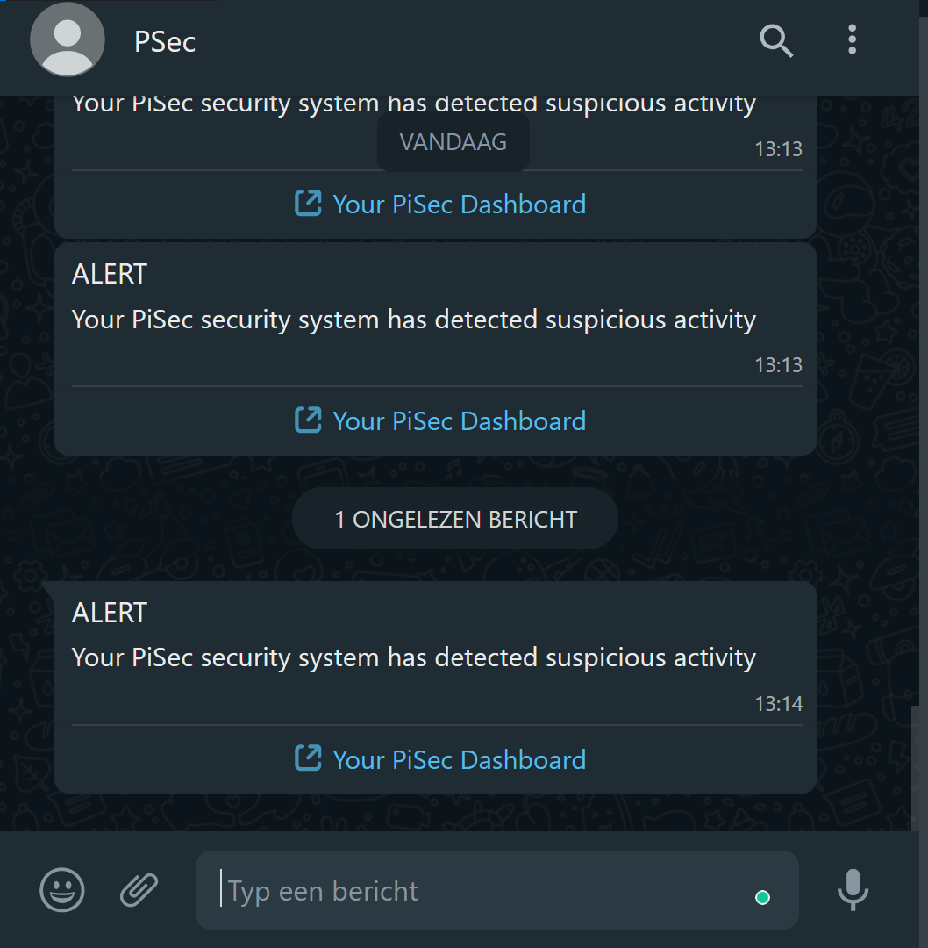
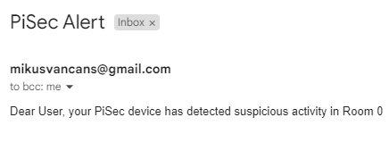
Send text & email alerts

Slide 9
Sprint 4 planning
Send alerts to web app
Enable livestream and allow program to store video/photos/
sounds
Add unit testing
Add account authorisation
Connect database to web interface

Slide 10
Q&A

